Slide 1
COVID-19 Cases
File created on: 24-03-2020 11:14:00

Slide 2
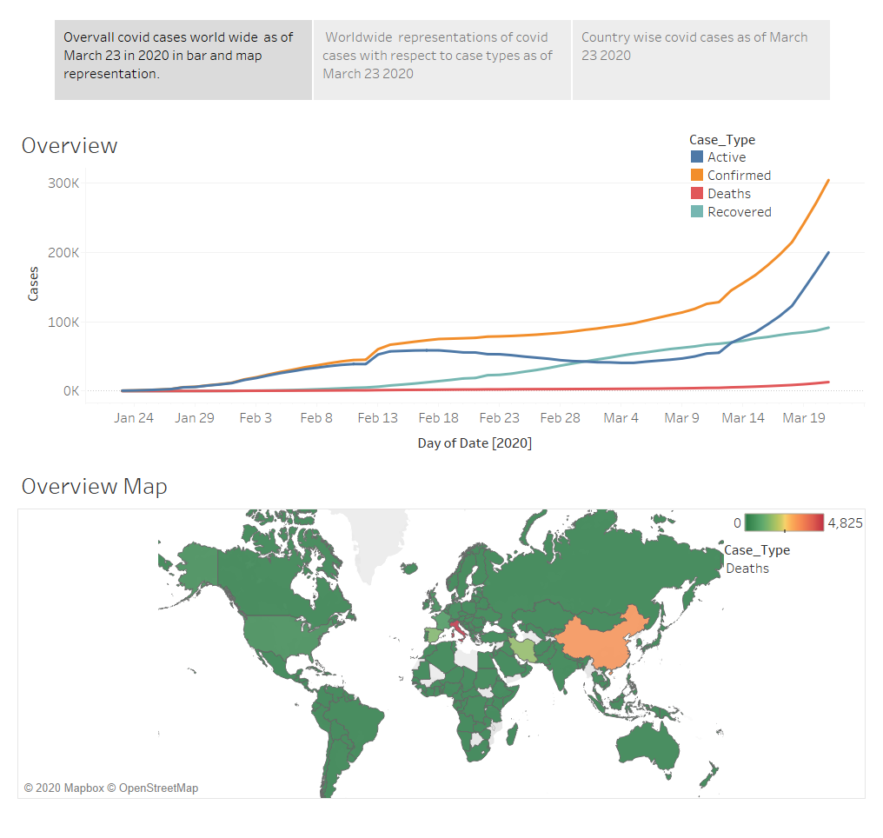

Slide 3
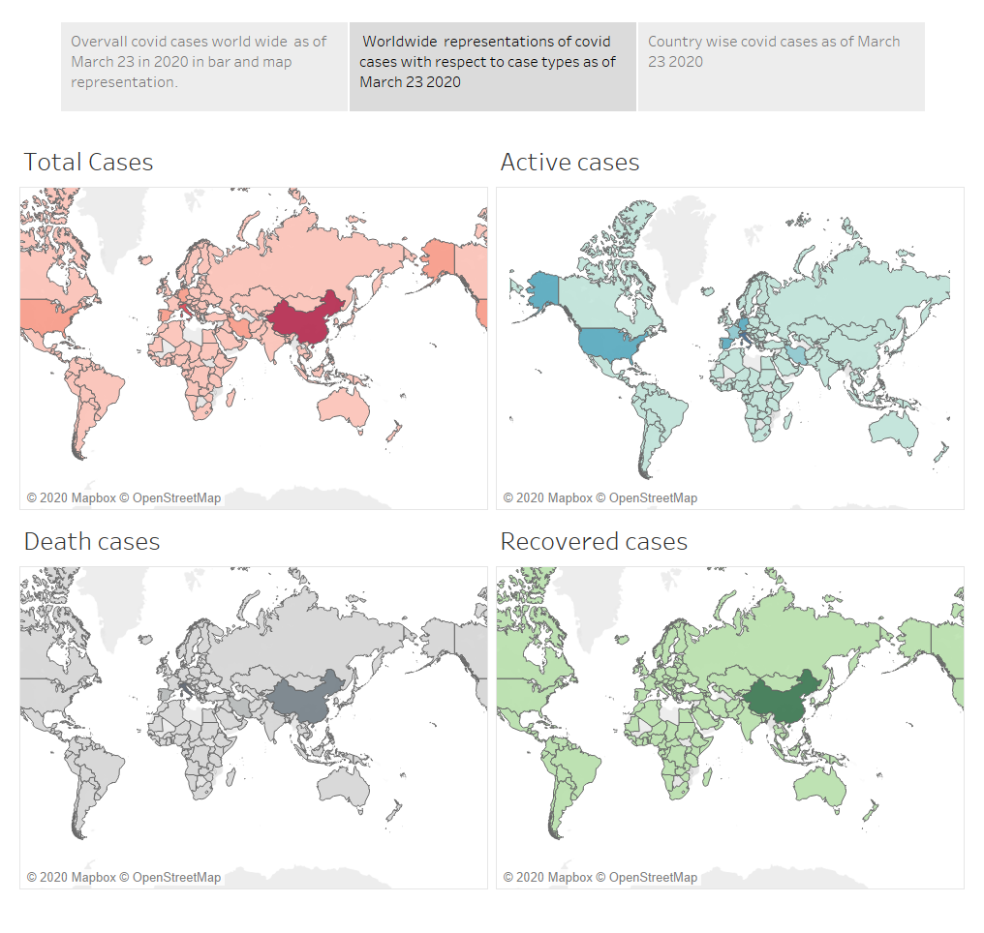

Slide 4
